Slide 1
Applet Fundamentals

Slide 2
Applet
Applet is a special type of program that is embedded in the webpage to generate the dynamic content. It runs inside the browser and works at client side.
After an applet arrives on the client, it has limited access to resources so that it can produce a graphical user interface and run various computations without introducing the risk of viruses or breaching data integrity.

Slide 3
Advantage of Applet
It works at client side so less response time.
Secured
It can be executed by browsers running under many plateforms, including Linux, Windows, Mac Os etc.
Drawback: Plugin is required at client browser to execute applet.

Slide 4
Applet class
The Applet class is contained in the java.applet package.
Applet contains several methods that give you detailed control over the execution of your applet.
In addition, java.applet also defines three interfaces: AppletContext, AudioClip, and AppletStub.

Slide 5
Two Types of Applets
The first are those based directly on the Applet class. These applets use the Abstract Window Toolkit (AWT) to provide the graphical user interface (or use no GUI at all). This style of applet has been available since Java was first created.
The second type of applets are those based on the Swing class JApplet, which inherits Applet. Swing applets use the Swing classes to provide the GUI. Swing offers a richer and often easier-to-use user interface than does the AWT. Thus, Swing-based applets are now the most popular.

Slide 6
Applet Basics
AWT-based applets are subclasses of Applet. Applets are not stand-alone programs. Instead, they run within either a web browser or an applet viewer.
Execution of an applet does not begin at main( ).
Output to your applet’s window is not performed by System.out.println( ). Rather, in an AWT-based applet, output is handled with various AWT methods, such as drawString( ), which outputs a string to a specified X,Y location. Input is also handled differently than in a console application.

Slide 7
There are two basic deployment strategies
The first is to use the Java Network Launch Protocol (JNLP). This approach offers the most flexibility, especially as it relates to rich Internet applications. For real-world applets that you create, JNLP will often be the best choice.
The second basic approach to deploying an applet is to specify the applet directly in an HTML file, without the use of JNLP. APPLET tag is used for this.When an APPLET tag is encountered in the HTML file, the specified applet will be executed by a Java-enabled web browser.
<applet code="MyApplet" width=200 height=60>
</applet>

Slide 8
The Applet Class
Applet provides all necessary support for applet execution, such as starting and stopping.
It also provides methods that load and display images, and methods that load and play audio clips.
Applet extends the AWT class Panel. In turn, Panel extends Container, which extends Component.
These classes provide support for Java’s window-based, graphical interface.

Slide 9
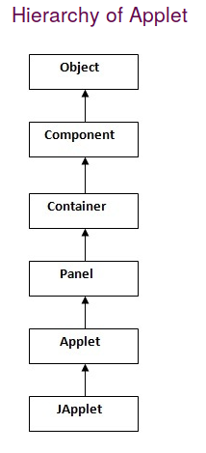

Slide 10
Lifecycle of Java Applet
Applet is initialized.
Applet is started.
Applet is painted.
Applet is stopped.
Applet is destroyed.

Slide 11
The java.applet.Applet class 4 life cycle methods and java.awt.Component class provides 1 life cycle methods for an applet.
java.applet.Applet class
For creating any applet java.applet.Applet class must be inherited. It provides 4 life cycle methods of applet.
public void init(): is used to initialized the Applet. It is invoked only once.
public void start(): is invoked after the init() method or browser is maximized. It is used to start the Applet.
public void stop(): is used to stop the Applet. It is invoked when Applet is stop or browser is minimized.
public void destroy(): is used to destroy the Applet. It is invoked only once.
java.awt.Component class
The Component class provides 1 life cycle method of applet.
public void paint(Graphics g): is used to paint the Applet. It provides Graphics class object that can be used for drawing oval, rectangle, arc etc.

Slide 12
Applet Architecture
1.Applets are event driven.
Ie, An applet waits until an event occurs. The run-time system notifies the applet about an event by calling an event handler that has been provided by the applet. Once this happens, the applet must take appropriate action and then quickly return.

Slide 13
2.The user initiates interaction with an applet—not the other way around.
As you know, in a console-based program, when the program needs input, it will prompt the user and then call some input method, such as readLine( ).
This is not the way it works in an applet. Instead, the user interacts with the applet as he or she wants, when he or she wants. These interactions are sent to the applet as events to which the applet must respond.

Slide 14
An Applet Skeleton
All but the most trivial applets override a set of methods that provides the basic mechanism by which the browser or applet viewer interfaces to the applet and controls its execution.
Four of these methods, init( ), start( ), stop( ), and destroy( ), apply to all applets and are defined by Applet.
Default implementations for all of these methods are provided.
Applets do not need to override those methods they do not use. However, only very simple applets will not need to define all of them.

Slide 15
AWT-based applets will also often override the paint( ) method, which is defined by the AWT Component class. This method is called when the applet’s output must be redisplayed

Slide 16
// An Applet skeleton.
import java.awt.*;
import java.applet.*;
/*
<applet code="AppletSkel" width=300 height=100>
</applet>
*/
public class AppletSkel extends Applet {
// Called first.
public void init() {
// initialization
}

Slide 17
/* Called second, after init().
the applet is restarted. */
public void start() {
// start or resume execution
}
Also called whenever
// Called when the applet is stopped.
public void stop() {
// suspends execution
}
/* Called when applet is terminated.
method executed. */
public void destroy() {
// perform shutdown activities
}

Slide 18
/* Called when applet is terminated.
method executed. */
public void destroy() {
// perform shutdown activities
}
This is the last
// Called when an applet’s window must be restored.
public void paint(Graphics g) {
// redisplay contents of window
}
}

Slide 19
Although this skeleton does not do anything, it can be compiled and run.
When run, it generates empty window when viewed with appletviewer.

Slide 20
Applet Initialization and Termination
When an applet begins, the following methods are called, in this sequence:
1. init( )
2. start( )
3. paint( )
When an applet is terminated, the following sequence of method calls takes place:
1. stop( )
2. destroy( )

Slide 21
init( )
The init( ) method is the first method to be called. This is where you should initialize variables. This method is called only once during the run time of your applet.
start( )
The start( ) method is called after init( ). It is also called to restart an applet after it has been stopped. Whereas init( ) is called once—the first time an applet is loaded—start( ) is called each time an applet’s HTML document is displayed onscreen. So, if a user leaves a web page and comes back, the applet resumes execution at start( ).

Slide 22
paint( )
The paint( ) method is called each time an AWT-based applet’s output must be redrawn. This situation can occur for several reasons.
For example, the window in which the applet is running may be overwritten by another window and then uncovered. Or the applet window may be minimized and then restored. paint( ) is also called when the applet begins execution. Whatever the cause, whenever the applet must redraw its output, paint( ) is called.
The paint( ) method has one parameter of type Graphics. This parameter will contain the graphics context, which describes the graphics environment in which the applet is running. This context is used whenever output to the applet is required.

Slide 23
stop( )
The stop( ) method is called when a web browser leaves the HTML document containing the applet—when it goes to another page, for example. When stop( ) is called, the applet is probably running. You should use stop( ) to suspend threads that don’t need to run when the applet is not visible. You can restart them when start( ) is called if the user returns to the page.
destroy( )
The destroy( ) method is called when the environment determines that your applet needs to be removed completely from memory. At this point, you should free up any resources the applet may be using. The stop( ) method is always called before destroy( ).

Slide 24
Overriding update( )
In some situations, an AWT-based applet may need to override another method defined by the AWT, called update( ). This method is called when your applet has requested that a portion of its window be redrawn. The default version of update( ) simply calls paint( ). However, you can override the update( ) method so that it performs more subtle repainting.

Slide 25
A simple applet
import java.awt.*;
import java.applet.*;
public class SimpleApplet extends Applet {
public void paint(Graphics g) {
g.drawString("A Simple Applet", 20, 20);
}
}

Slide 26
This applet begins with two import statements.
The first imports the Abstract Window Toolkit (AWT) classes. Applets interact with the user through a GUI framework, not through the console-based I/O classes. One of these frameworks is the AWT.
The second import statement imports the applet package, which contains the class Applet. Every AWT-based applet that you create must be a subclass (either directly or indirectly) of Applet.

Slide 27
The next line in the program declares the class SimpleApplet. This class must be declared as public, because it will be accessed by code that is outside the program.
Inside SimpleApplet, paint( ) is declared. This method is defined by the AWT and must be overridden by the applet. paint( ) is called each time that the applet must redisplay its output.
The paint( ) method has one parameter of type Graphics. This parameter contains the graphics context, which describes the graphics environment in which the applet is running.

Slide 28
Inside paint( ) is a call to drawString( ), which is a member of the Graphics class. This method outputs a string beginning at the specified X,Y location.
general form:
  void drawString(String message, int x, int y)
Here, message is the string to be output beginning at x,y.
In a Java window, the upper-left corner is location 0,0.
The call to drawString( ) in the applet causes the message "A Simple Applet" to be displayed beginning at location 20,20.

Slide 29
Compiling and Running applet
After you enter the source code for SimpleApplet, compile in the same way that you have been compiling programs.
There are two ways in which you can run an applet:
• Executing the applet within a Java-compatible web browser.
• Using an applet viewer, such as the standard tool, appletviewer. An applet viewer executes your applet in a window. This is generally the fastest and easiest way to test your applet.

Slide 30
One way to execute an applet in a web browser is to write a short HTML text file that contains a tag that loads the applet. At the time of this writing, Oracle recommends using the APPLET tag for this purpose. (The OBJECT tag can also be used. ) Using APPLET, here is the HTML file that executes SimpleApplet:
<applet code="SimpleApplet" width=200 height=60>
</applet>
The width and height statements specify the dimensions of the display area used by the applet.

Slide 31
To execute SimpleApplet with an applet viewer, you may also execute the HTML file shown earlier.
For example, if the preceding HTML file is called RunApp.html, then the following command line will run SimpleApplet:
C:\>appletviewer RunApp.html

Slide 32
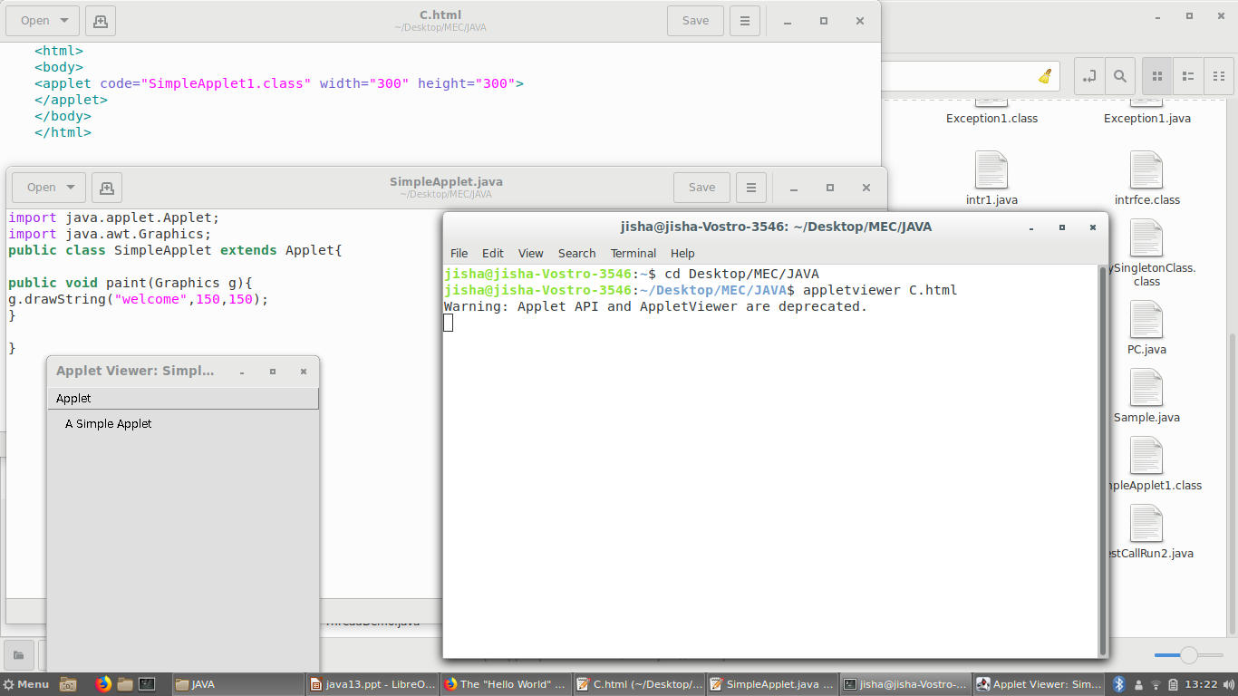

Slide 33
However, a more convenient method exists that you can use to speed up testing.
Simply include a comment at the head of your Java source code file that contains the APPLET tag. By doing so, your code is documented with a prototype of the necessary HTML statements, and you can test your compiled applet merely by starting the applet viewer with your Java source code file.

Slide 34
import java.awt.*;
import java.applet.*;
/*
<applet code="SimpleApplet" width=200 height=60>
</applet>
*/
public class SimpleApplet extends Applet {
public void paint(Graphics g) {
g.drawString("A Simple Applet", 20, 20);
}
}

Slide 35
With this approach, you can quickly iterate through applet development by using these
three steps:
1. Edit a Java source file.
2. Compile your program.
3. Execute the applet viewer, specifying the name of your applet’s source file. The
applet viewer will encounter the APPLET tag within the comment and execute your applet.

Slide 36
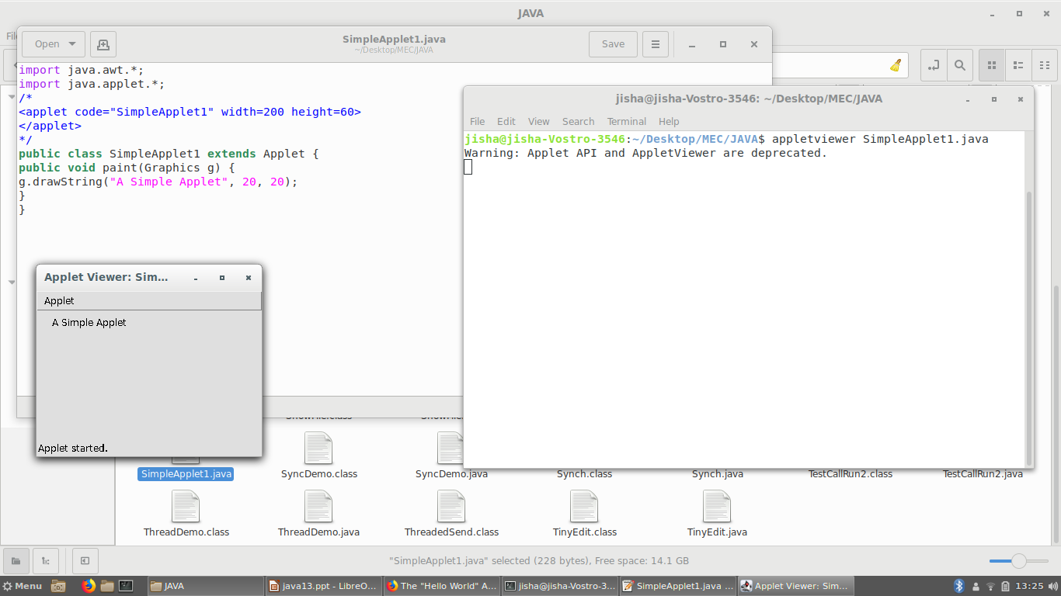

Slide 37
Simple Applet Display Methods
applets are displayed in a window, and AWT-based applets use the AWT to perform input and output.
To set the background color of an applet’s window, use setBackground( ). To set the foreground color (the color in which text is shown, for example), use setForeground( ).
These methods are defined by Component, and they have the following general forms:
void setBackground(Color newColor)
void setForeground(Color newColor)
Here, newColor specifies the new color. The class Color defines the constants shown here that can be used to specify colors:

Slide 38
Color.black Color.magenta
Color.blue Color.orange
Color.cyan Color.pink
Color.darkGray Color.red
Color.gray Color.white
Color.green Color.yellow
Color.lightGray
Uppercase versions of the constants are also defined.

Slide 39
setBackground(Color.green);
setForeground(Color.red);
A good place to set the foreground and background colors is in the init( ) method.
Of course, you can change these colors as often as necessary during the execution of your applet.
You can obtain the current settings for the background and foreground colors by calling getBackground( ) and getForeground( ), respectively. They are also defined by Component and are shown here:
Color getBackground( )
Color getForeground( )

Slide 40
import java.awt.*;
import java.applet.*;
/*
<applet code="Sample" width=300 height=50>
</applet>
*/
public class Sample extends Applet{
String msg;
public void init() {
setBackground(Color.cyan);
setForeground(Color.red);
msg = "Inside init( ) --";
}

Slide 41
public void start() {
msg += " Inside start( ) --";
}
public void paint(Graphics g) {
msg += " Inside paint( ).";
g.drawString(msg, 10, 30);
}
}

Slide 42
